Slide 1

Aggregate Functions
Aggregate functions retrieve a single value after performing a calculation on a set of values. In general, aggregate functions ignore null values. Often, aggregate functions are use with GROUP BY clause of the SELECT statement.
Infoway Technologies, 3rd Floor Commerce Centre, Rambaug Colony, Paud Road Pune 411038

Slide 2
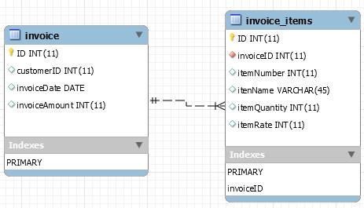
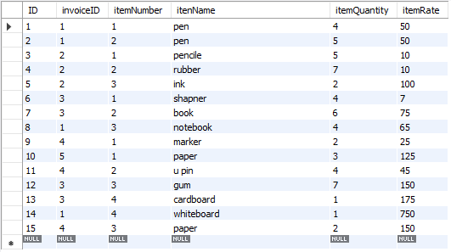
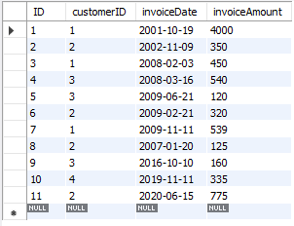
Aggregate Functions
SELECT * FROM invoice;
SELECT * FROM invoice_items;
Infoway Technologies, 3rd Floor Commerce Centre, Rambaug Colony, Paud Road Pune 411038

Slide 3
Aggregate Functions
SUM function
The SUM function which returns the sum of all the values in the specified column. SUM works on numeric fields only. Null values are excluded from the result returned.
SELECT sum(invoiceAmount) "Total invoice amount for all customer" FROM invoice;
SELECT customerID, sum(invoiceAmount) "Total invoice amount for each customer " FROM invoice GROUP BY customerID;
AVG function
The AVG function returns the average of the values in a specified column. Just like the SUM function, it works only on numeric data types.
SELECT avg(invoiceAmount) "Average invoice amount for all customer" FROM invoice;
SELECT customerID, avg(invoiceAmount) "Average invoice amount for each customer" FROM invoice GROUP BY customerID;
Infoway Technologies, 3rd Floor Commerce Centre, Rambaug Colony, Paud Road Pune 411038

Slide 4
Aggregate Functions
COUNT Function
The COUNT function returns the total number of values in the specified field. It works on both numeric and non-numeric data types. All aggregate functions by default exclude nulls values before working on the data.
COUNT (*) is a special implementation of the COUNT function that returns the count of all the rows in a specified table. COUNT (*) also considers Nulls and duplicates.
SELECT count(ID) "Total invoices" FROM invoice;
SELECT customerID, count(ID) "Total invoices for each customer" FROM invoice GROUP BY customerID;
MIN function
The MIN function returns the smallest value in the specified table field.
SELECT min(invoiceAmount) "Minimum invoices amount" FROM invoice;
SELECT customerID, min(invoiceAmount) "Minimum invoices for each customer" FROM invoice group by customerID;
Infoway Technologies, 3rd Floor Commerce Centre, Rambaug Colony, Paud Road Pune 411038

Slide 5
Aggregate Functions
MAX function
Just as the name suggests, the MAX function is the opposite of the MIN function. It returns the largest value from the specified table field.
SELECT max(invoiceAmount) "Maximum invoices amount" FROM invoice;
SELECT customerID, max(invoiceAmount) " Maximum invoices for each customer" FROM invoice group by customerID;
Infoway Technologies, 3rd Floor Commerce Centre, Rambaug Colony, Paud Road Pune 411038

